Slide 1






Slide 2
InTRODUCTION
This project came about during the last Science on Stage festival held in London in 2015. Silvio suggested that we could do a Joint Project together which would involve research amongst students from The Netherlands and Spain about the paranormal and supernatural phenomenons based on Physics laws.
Ghosts, spirits and a long list of supernatural happenings have fascinated humanity as far back as we can recall therefore I thought that it was an incredibly spooky and great idea so I accepted the challenge.

Slide 3
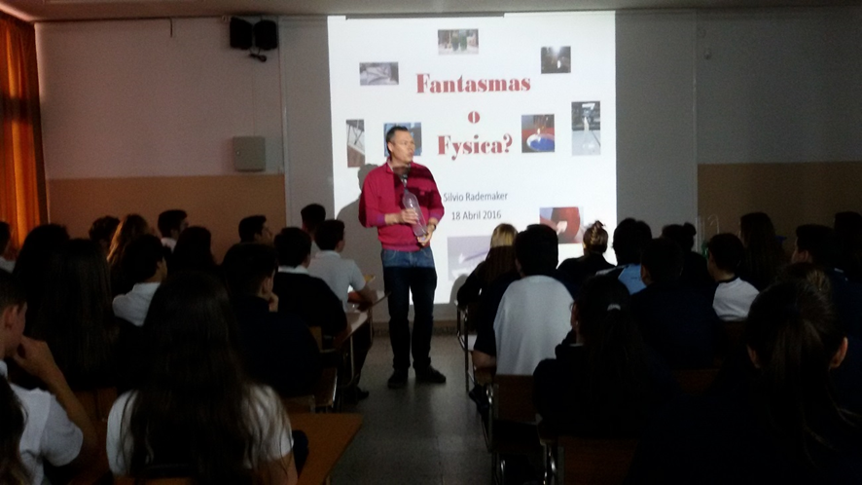
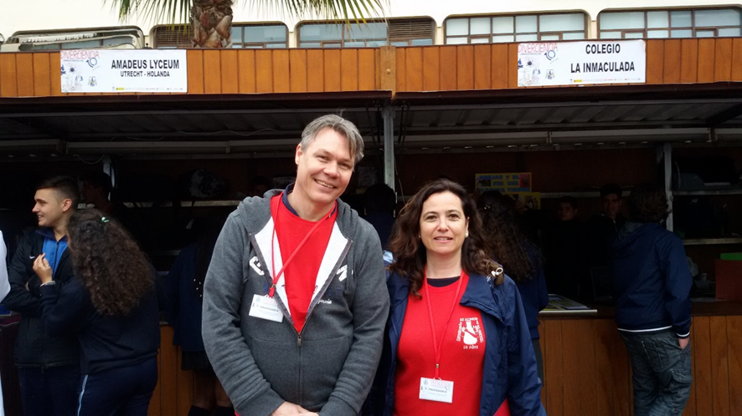
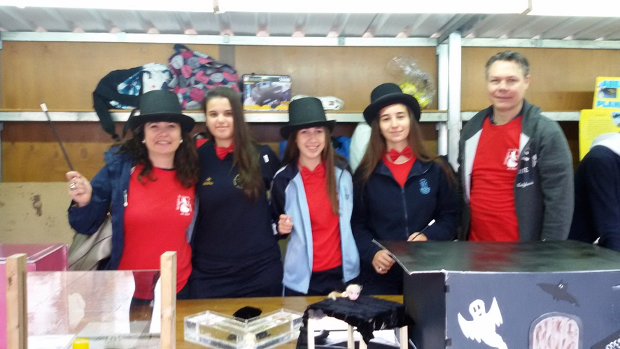
Silvio visited our School
LA INMACULADA and the
Science Fair DIVERCIENCIA
in Algeciras last April.

Slide 4

We’ve split our Project into two parts:
In the first part, we’ve studied what the influence of literature and theatre had on the inventions during the 19 th century when phantasmagorias were used in live shows.
The second one is the experimental part which consists of reproducing those inventions. The study of light as a wave movement clearly demonstrates the Physics behind every single invention.

Slide 5

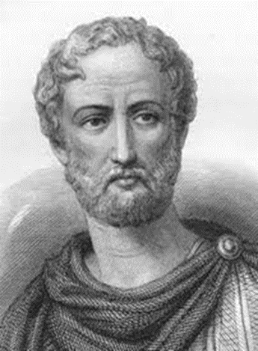
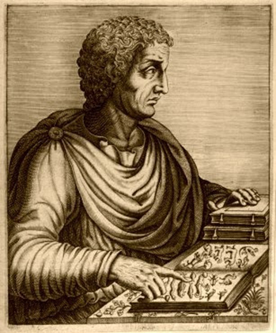
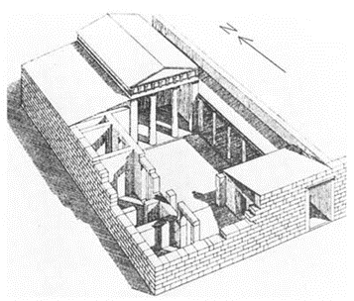
My students started investigating why phantoms cause so much fascination throughout History and have even been a source of inspiration for literature and theatre.
We found that Pliny The Younger (61 – 112 aC) wrote a letter about the story of a haunted house in which a phantom lived.

Slide 6

“There was at Athens a large and spacious, but illreputed and pestilential house. In the dead of the night a noise, resembling the clashing of iron, was frequently heard, which, if you listened more attentively, sounded like the rattling of fetters; at first it seemed at a distance, but approached nearer by degrees; immediately afterward a phantom appeared in the form of an old man, extremely meagre and squalid, with a long beard and bristling hair; rattling the gyves on his feet and hands…”

Slide 7
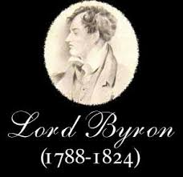
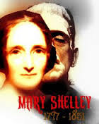
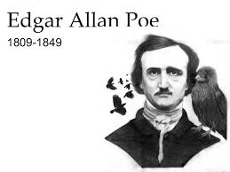
Later on, well known writers such as
Lord Byron, Mary Shelley or Edgar Allan Poe made numerous references in their works about ghosts during the romantic period.

Slide 8

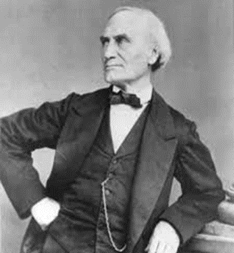
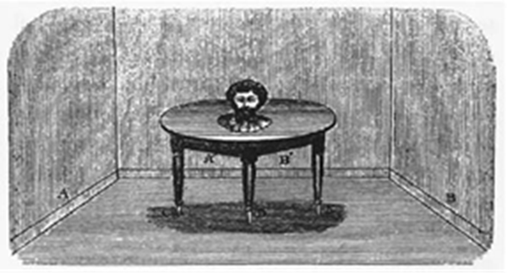
During Victorian times it was really fashionable for the high society to be seen at magic shows.
Jean Eugène Robert-Houdin, who was a French magician wrote a book entitled “Magic and recreative Physics” where he described the tricks of the bodyless talking head and the magic box.

Slide 9
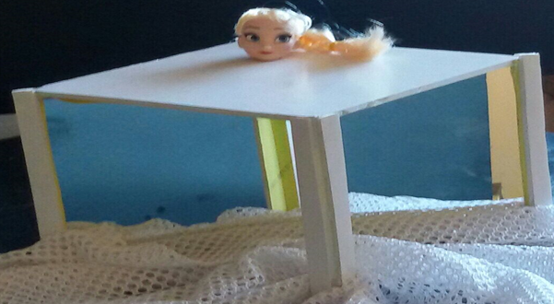
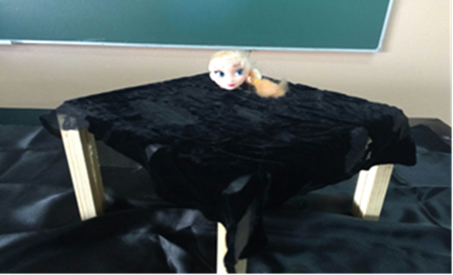
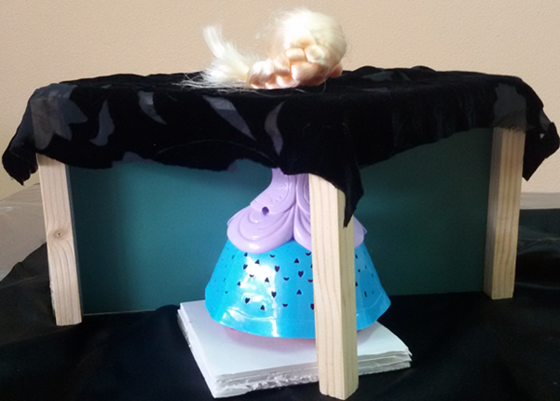

Slide 10

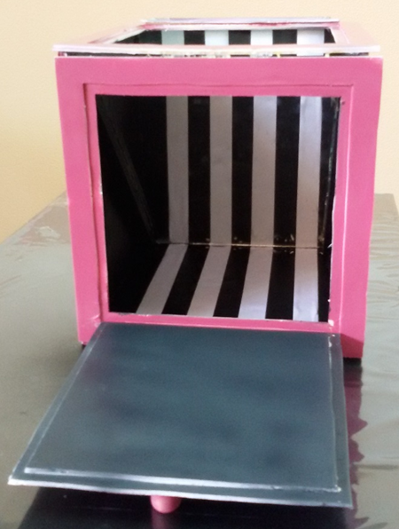
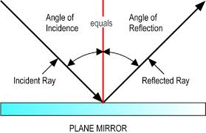

Slide 11
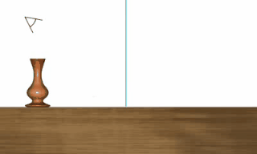
The fore mentioned tricks are based on the Reflection of light phenomenon.

Slide 12
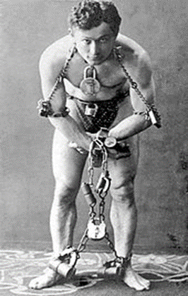
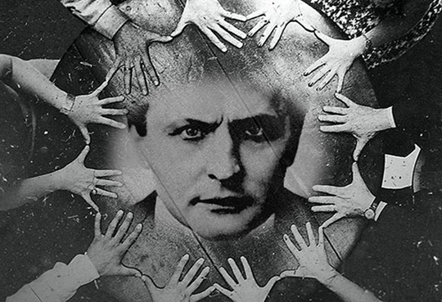
Harry Houdini was born in 1874 in Budapest (Hungary)
He is one of the other greatest magicians of all time, also great admiror of Houdin and magnificent escape artist!!!

Slide 13
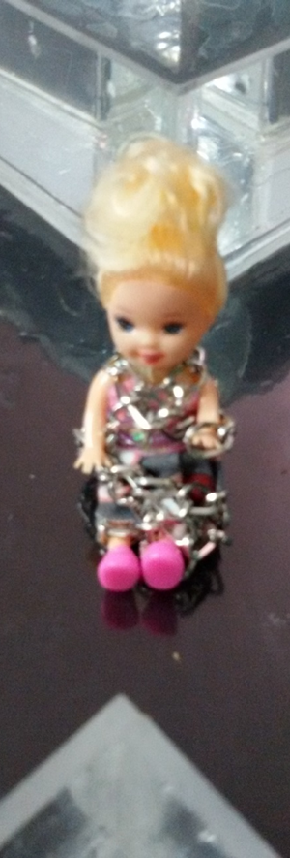
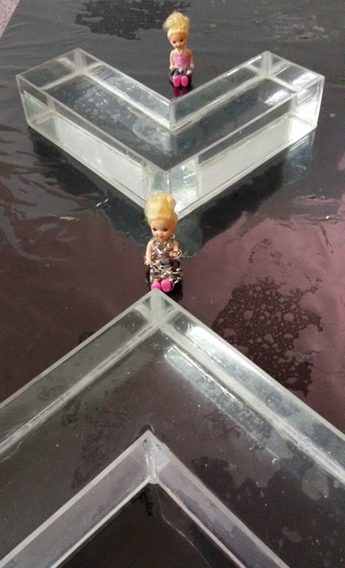
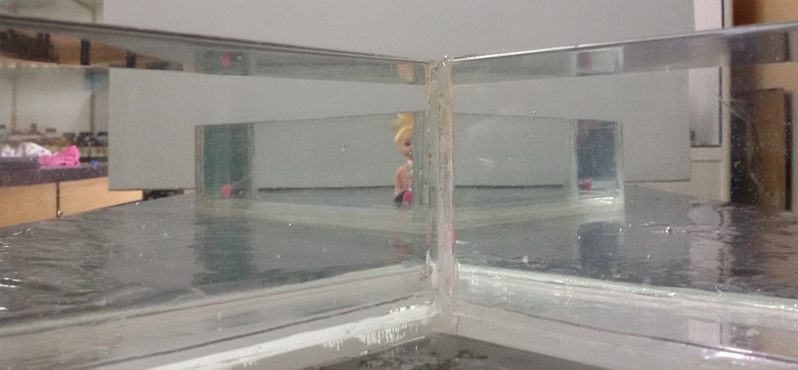

Slide 14
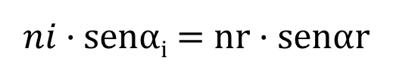
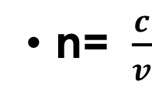
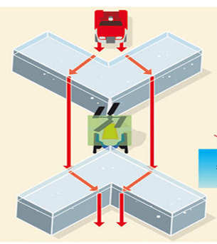
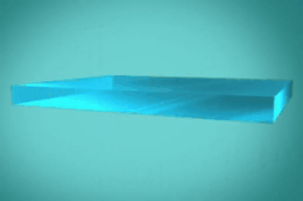
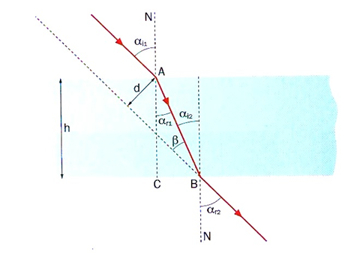
This experiment is based on the Snell’s Law and how light changes its direction so we get a shadowed zone which hides the object that is below water level.
Snell’s Law:
Snell’s law

Slide 15

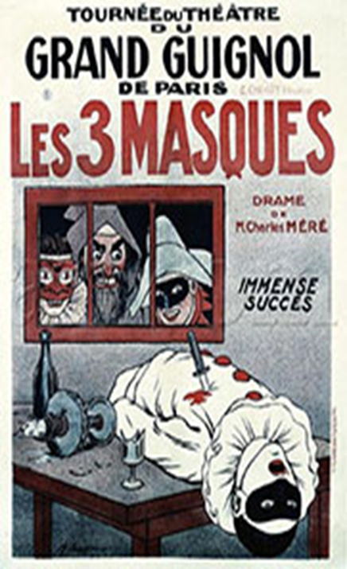
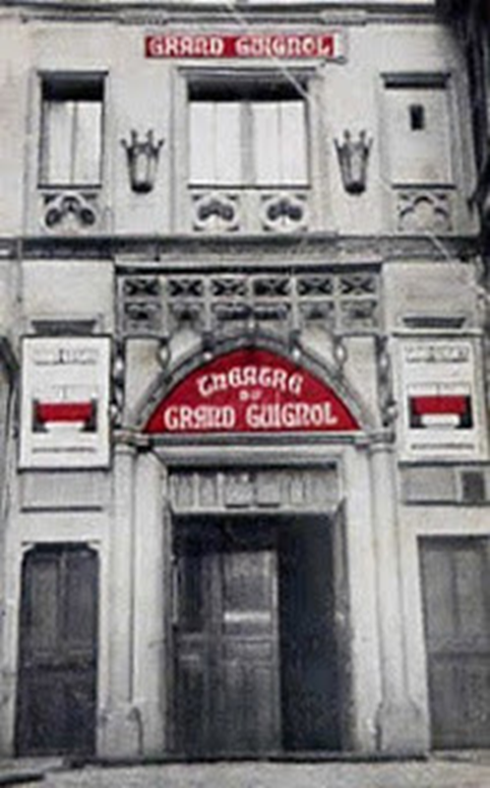
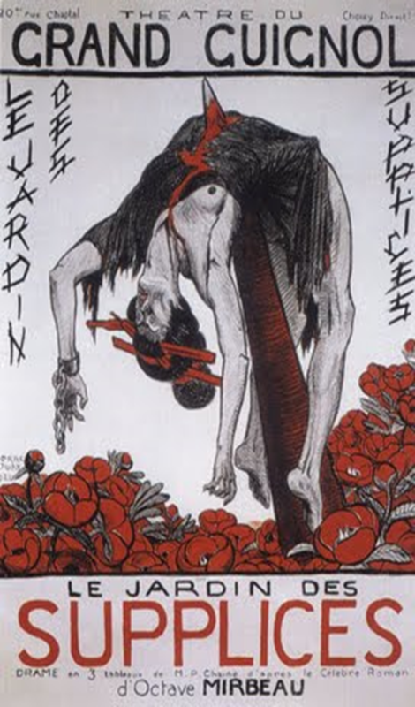
The inventions created for the special effects used in theatres throughout the 19 th century.

Slide 16

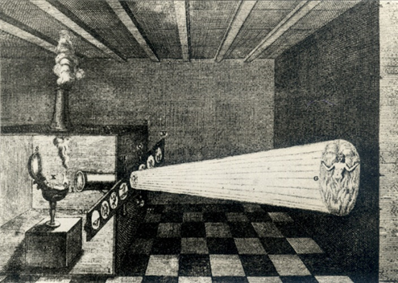
It is an optical device, which uses the same principal of the dark room and it’s predecessor of the cinematograph.

Slide 17
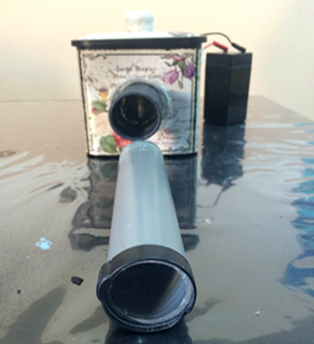
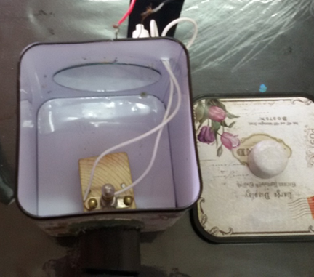
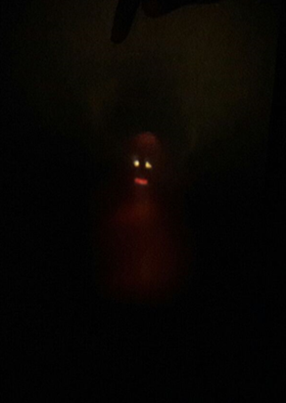
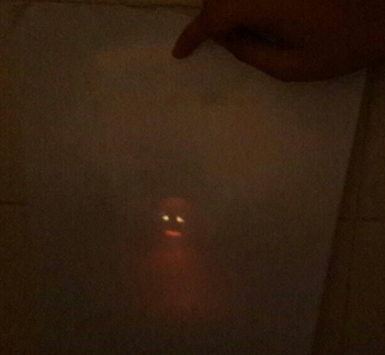
Our magic lantern has got two convergent lenses, a concave mirror and a light bulb.
This is the phantasmagoria that we’ve already created.

Slide 18
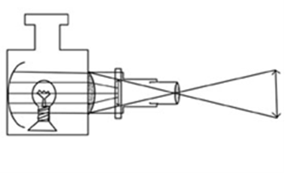
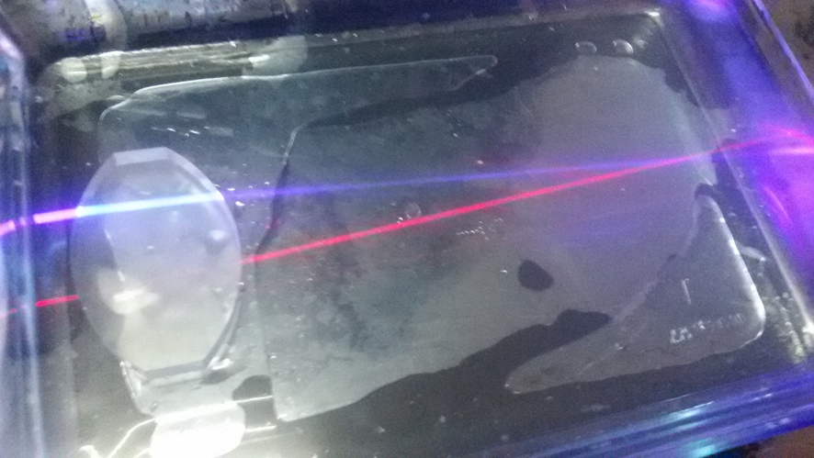
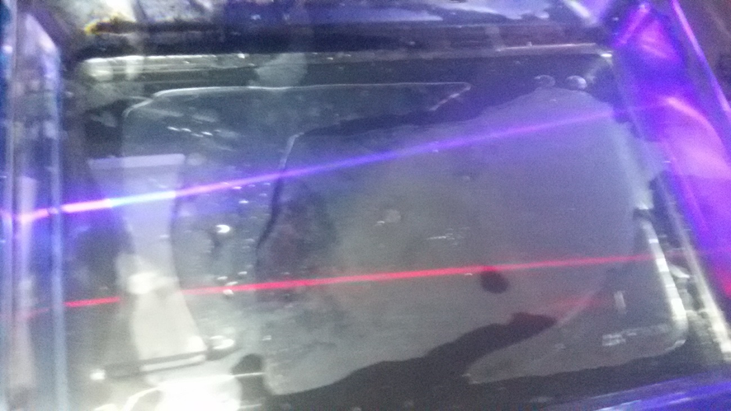
To understand the directions of the rays of light
We’ve used a coloidal mixture (water and milk) and based on the Tyndall Effect we can see the difference between the convergent and divergent lenses.

Slide 19
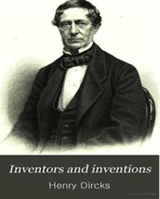
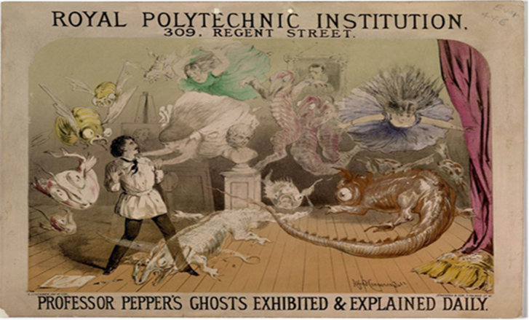
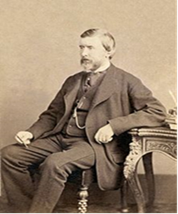
It was an optical illusion invented by Henry Dircks who was an engineer and John Pepper who was a chemist. Therefore the public were able to contemplate life like ghosts on stage.

Slide 20
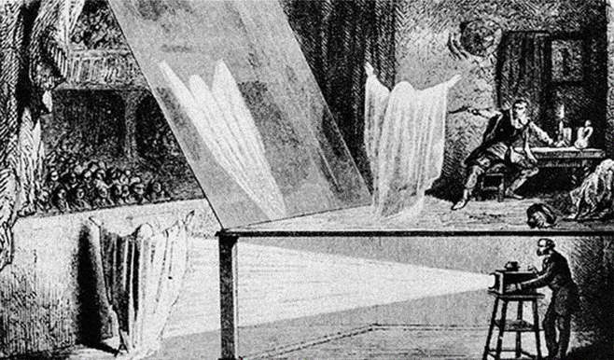
The trick consists of dividing the stage into two different rooms, separated by a transparent glass screen at a 45º angle. The public can only see one of them. The hidden room is called the blue room. When the main room is lit up we can only perceive the stage but if we make the blue room lighter we start to see a ghost like appearance at the front of the stage.

Slide 21
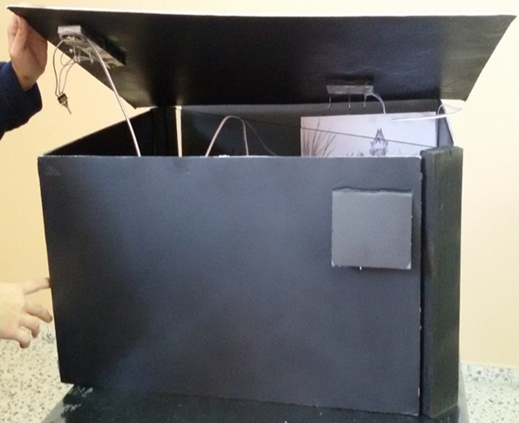
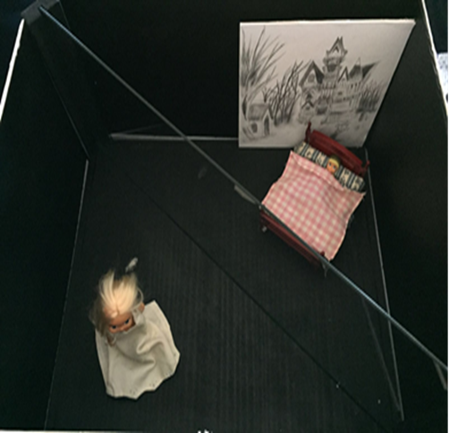
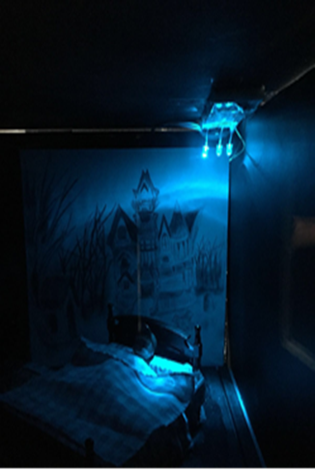
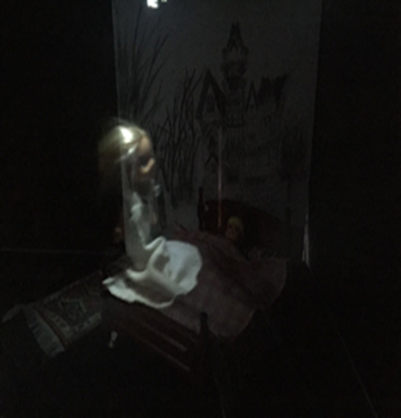

Slide 22

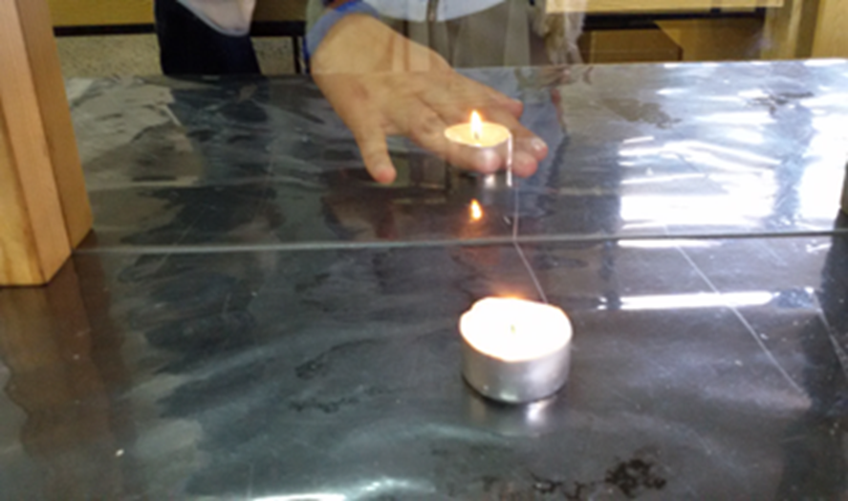
Using the Pepper’s Ghost Effect we’ve created several experiments, such as:
The candle that doesn’t burn you.

Slide 23
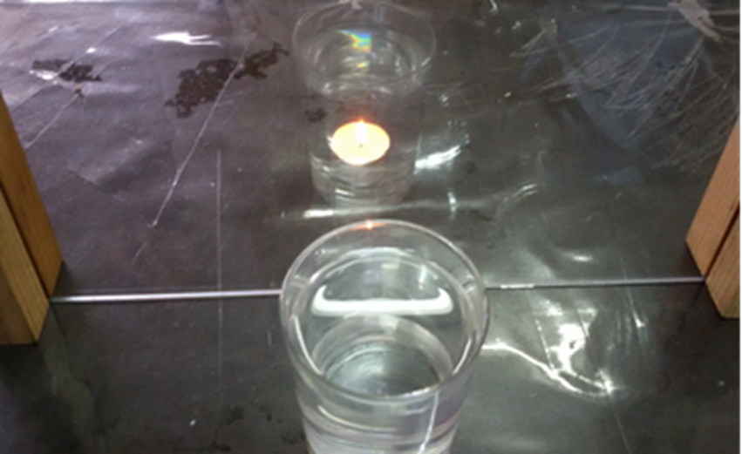
The candle that stay alight in water.

Slide 24
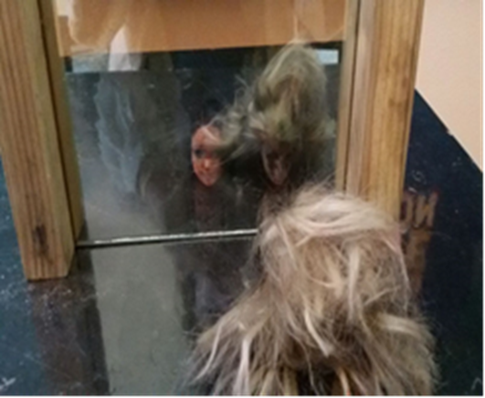
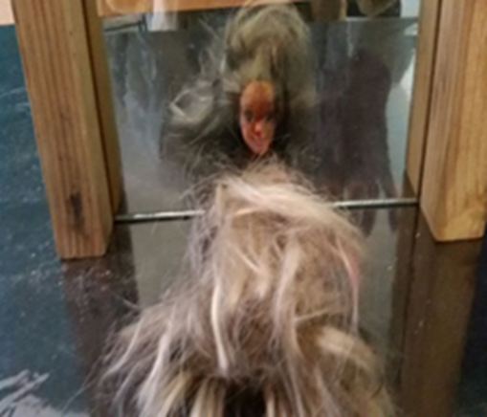
The metamorphosis illusion.

Slide 25

And a very handy artistic tool: The Reflectographer.

Slide 26

We’ve used a polarized glass screen throughout the fore mentioned experiments, introducing the study of light polarization.

Slide 27



The holography is an advanced technique of the 3 D photography. It was invented in 1947 by the Hungarian physician Dennis Gabor (1900-1979) and it’s based on the interference of light.

Slide 28


An outstanding and memorable example of this was used at the 2014 Billboard Music Awards when the hologram of Michael Jackson appeared on the stage.

Slide 29



We’ve transformed our school theatre into a Little film studio.

Slide 30


And we’ve created our own hologram.

Slide 31

Some of the conclusions of our Project are:
There have always been scientific celebrities that have put their knowledge to the service of society for its amusement.
The real purpose of the holography used in live shows today is very similar to the Pepper’s Ghost Effect used 2 centuries ago. It’s an advanced technique created so that people enjoy themselves whilst contemplating an optical illusion.

Slide 32

Canas Ana, Puente Julio, Remacha Mariano, Viguera J,Ángel. Libro de Física y Química 4ºESO, edición SM, págs. 163-165, 168, 169, 171.
Capdevila Arturo. Los Románticos: espectros, fantasmas y muñecos del romanticismo. Ed Cabaut, 1927.
De Espronceda José. Poema: El estudiante de Salamanca, parte I y IV.
Estalella José. Ciencia Recreativa.pdf
Lozano Óscar R., Solbes Jordi. .Libro: 85 Experimentos de Física cotidiana. Ed: Graó. Págs 189, 109, 191.
Smith Alan E. La sombra y otras sombras. Del romanticismo fantástico al realismo mitológico en Galdós. págs. 227-236
Zorrilla José. Poema: Don Juan Tenorio, parte II acto III.
Universitat de Lleida. Brujas, demonios y fantasmas en la literatura fantástica hispánica.
Alonso Juan de Dios, Pérez Máximo, Puente Julio, Romo Nicolás .Libro de Física 2º Bach, Ed SM págs138,139,170, 171,186-190,192, 195.
Urrero Guzmán. Cinefectos. Trucajes y sombras, Ed. Royal Books, págs. 1,2,5-17.

Slide 33

https://es.wikipedia.org/wiki/Fantasma_de_Pepper
• https://es.wikipedia.org/wiki/John_Henry_Pepper
• https://es.wikipedia.org/wiki/Fantasma_de_Pepper
• https://es.wikipedia.org/wiki/John_Henry_Pepper
• http://historiaycuriosidadesdelilusionismo.blogspot.com.es/2009/09/la- linterna- magica.html
• https://cinesilentemexicano.wordpress.com/2010/02/10/1303/
• http://www.maquinascientificas.es/13linterna%20magica.htm
• https://en.wikipedia.org/wiki/Pepper's_ghost
• http://fibraoptica.blog.tartanga.net/fundamentos-de-las-fibras-opticas/
• http://hyperphysics.phy-astr.gsu.edu/hbasees/geoopt/refr.html

Slide 34
http://www.monografias.com/trabajos93/topicos-selectos-fisica-optica/topicos-selectos-fisica- optica.shtml
• http://www.fisic.ch/cursos/primero-medio/reflexi%C3%B3n-de-la-luz-y-espejos-planos/
• http://precinemahistory.net/1850.htm
• http://fisica.mdp.edu.ar/mlhoyuelos/Fisicamagia.htm
• http://www.revistabiosofia.com/index.php?option=com_content&task=view&id=115&Itemid=40
• http://users.telenet.be/thomasweynants/garde-honneur.html
• https://es.wikipedia.org/wiki/Jean_Eugène_Robert-Houdin
• https://es.wikipedia.org/wiki/Harry_Houdini
• http://www.aulafacil.com/articulos/ciencia-y-tecnologia/t1304/experimento-de-mecanica-cuantica- casero-la-doble-rendija
• https://www.leica- microsystems.com/fileadmin/downloads/Leica%20DM750%20P/Brochures/Leica_Polarization_of_lig ht_RvAB Booklet_ES.pdf
• http://manualidades.facilisimo.com/blogs/ideas-diy/caja-magica-para-hacer-trucos-en-fiestas-con- ninos_1679560.html

Slide 35
http://quimica.laguia2000.com/general/efecto-tyndall
http://www.equiposylaboratorio.com/sitio/contenidos_mo.php?it=3059
http://biofisicaopticageo.blogspot.com.es/
http://fq-experimentos.blogspot.com.es/2011_06_01_archive.html

Slide 36

To my School, The Inmaculada.
To my students.
To my family.
To our Science Fair Diverciencia.
To Silvio Rademaker.
To Science on Stage.
To Werkgreop Natuurkunde Didaktiek.

Slide 37
This Project have been done by my students:
María Escobar Montes Enrique José Martínez Contreras Patricia Fernández Galindo Álvaro Sánchez Mayor Belén Castelló Riquelme Francisco Ruiz Alarcón Javier Ochoa Moya Lucia Ortega García Blanca Guerrero Benítez
Directed by
Nuria Muñoz
The Inmaculada School, Spain

Slide 38


